Slide 1
Metatranscriptomics: ready for prime time?
Greg Gloor
U. Western Ontario
Department of Biochemistry
ggloor@uwo.ca : @gbgloor

Slide 2

The goal
Given a metatranscriptome dataset:
Identify taxa that are driving difference between groups
Identify genes that contribute to that difference regardless of taxa
Identify functional differences
Ideally analyses are internally consistent
Notes:
Many more fragments than we can count

Slide 3
Why is this hard (part 1)?
Lots of moving parts
Species can:
==
∆ abundance
∆ occurrence
Genes can:
==
∆ abundance
∆ occurrence
Notes:
Many more fragments than we can count

Slide 4
Why is this hard (part 2)
We don’t measure the moving parts directly
Gloor et al Front. Micro. 2017

Slide 5
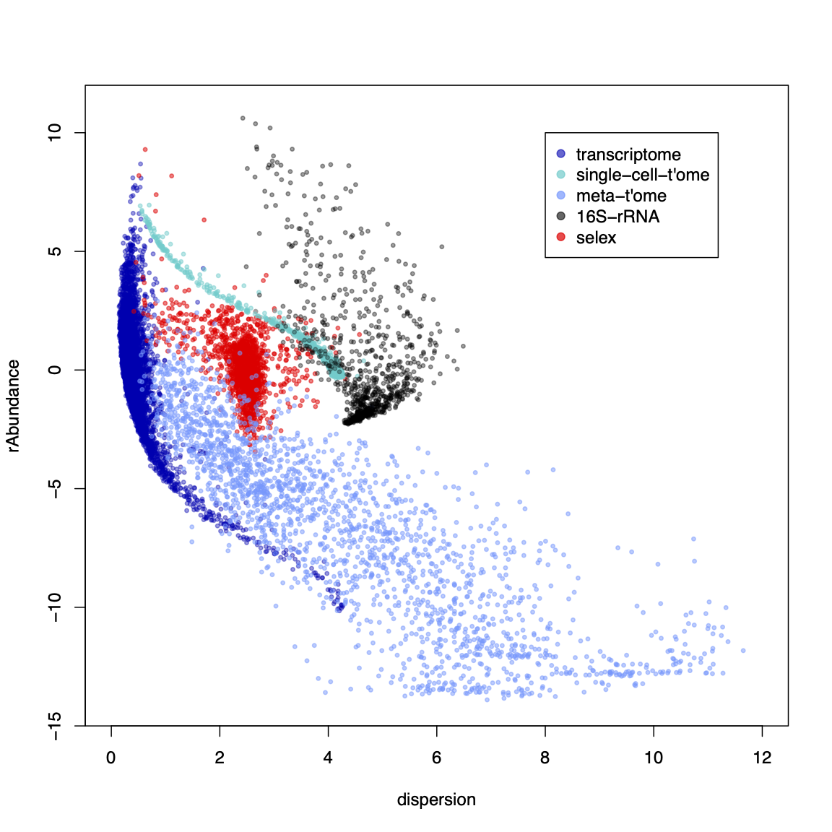
Why is this hard (part 3)?
Most tools are
designed for:
This
Maybe this
Not this
Or this
Definitely not this

Slide 6
We have problems
Sequencing data are probabilistic random samples
Almost always point estimates or worse – averages
Sequencing data are compositions
everything correlates with everything
the levels are confounded if the bacterial load (or the total amount of mRNA) differs between samples
our conclusions change when we include or exclude different sets of features
(Pearson 1896 Proceedings of the Royal Society of London 60, 489: Aitchison 1986 The Statistical Analysis of Compositional Data: Lovell 2015 PLoS Comput Bio,11:e1004075 )
Sequencing data are high-dimensional
Therefore statistical analyses can be wildly optimistic
Sequencing data are sparse
Therefore we need to estimate many of our values
Most of us are, at best, begrudgingly aware of the problems

Slide 7
Data as counts
Example 100 random sample sets
range=1800-2200
range= 8000-12000
range=450-550
🐯
🐞
👽
Gloor et al Front. Micro. 2017

Slide 8
As delivered by sequencing
Constant sum of 1000
Constant sum operations:
Count normalization
Rarefaction
Proportion
percentage, relative abundance
Sequencing
Simplex: one fewer dimensions than variables
Problems remain regardless of dimension
Gloor et al Front. Micro. 2017

Slide 9
Normalization is no help at all
Once data are on the simplex, they cannot be removed easily

Slide 10
Log-ratios for CoDa
Count
Sequencing
Simplex
27
853
66
740
112
216
clr(x) = [ log(x₁/g_{X}), log(x₂/g_{X}), … log(x_{D}/g_{X}) ]
X = [ x₁, x₂, … x_{D} ], g_{X} = geometric mean of X
Aitchison 1986. Stat. Anal. Comp Data
Pawlowsky-Glahn, 2015. Mod. Anal. CoDa
Notes:
Scale dependence - hence ‘normalization’
Correlation and covariation are unreliable
Addition and subtraction are not useful operations
Subsetting and aggregating are problematic
Sparse data is an issue

Slide 11
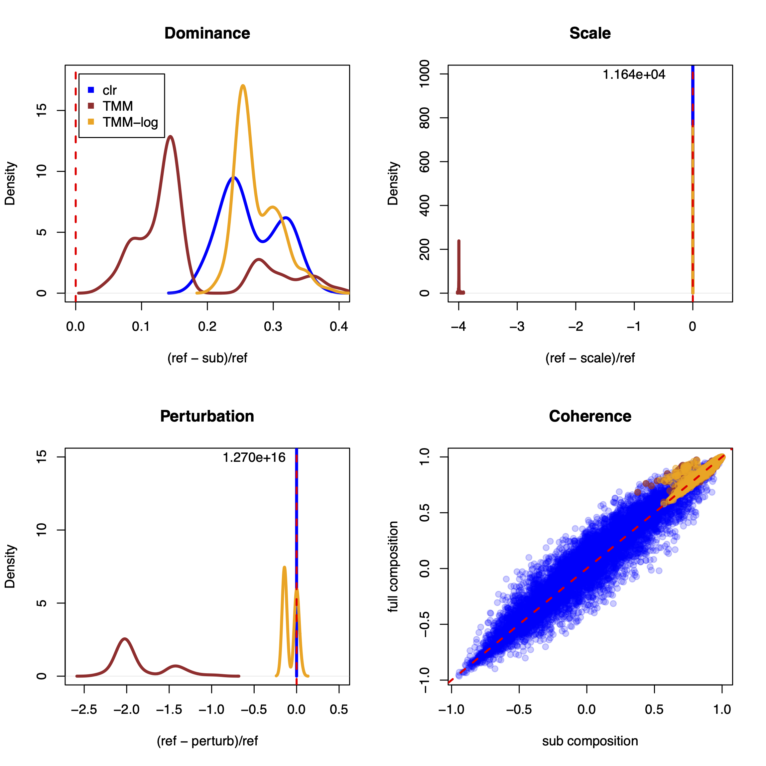
Normalization
TMM/RLE normalization does not:
Provide a common scale
Protect vs. perturbation (batch)
Give rational correlations in small datasets
TMM/RLE normalization does:
Usually provide consistent distances with filtered data
Log-ratios behave rationally under all scenarios – internal consistency with subsets
Gloor(2022) CRAN:aIc

Slide 12
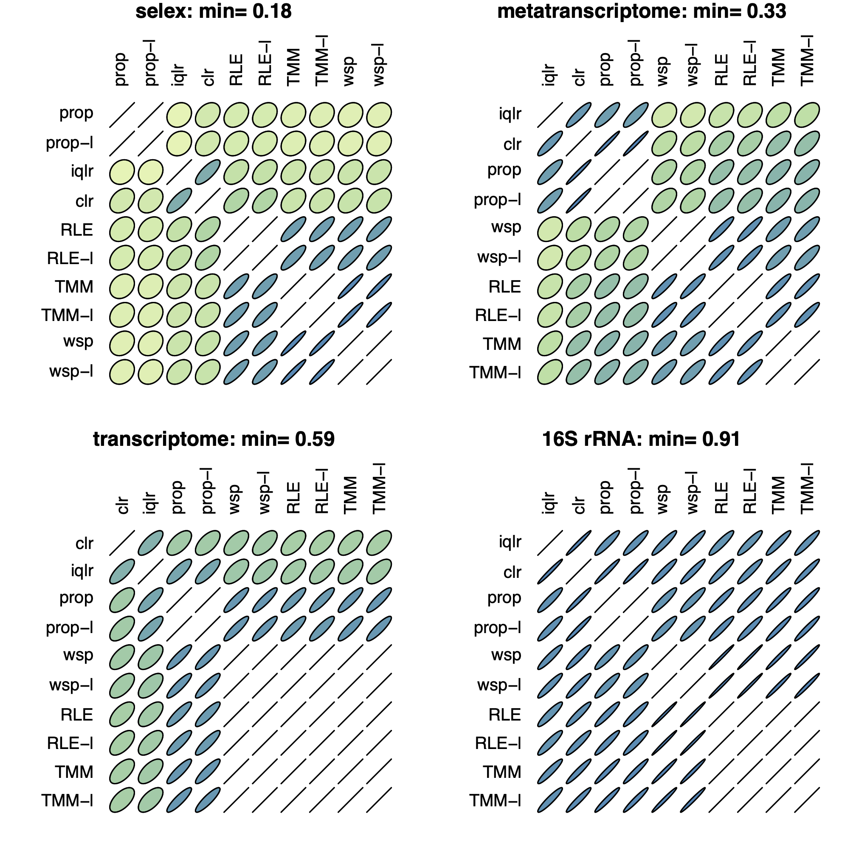
A note on correlation
Correlations observed vary greatly by normalization method
They become more concordant between normalization methods as the sample size increases
Selex N=7
MT N=12
TS N=48
16S N=160
SS N>100, min>0.98

Slide 13
ALDEx2 does and does not
Does not
Estimate parameters
Assume distributions
Pool information across features
Subset the data
‘Correct’ for sequencing depth
Does
Estimate probability distributions directly from data
Include a maximally uninformative prior distribution
Account for measurement error
Manipulate probabilities using rules and tools of CoDa
Report the mean ensemble value by default

Slide 14
ALDEx2: probabilistic CoDa
Group 1 Group 2
Generate posterior estimates of the data consistent with the observed data and the chosen prior(s)
Dirichlet instances
lr transform instances
Calculate test values on each instance
Correct for FDR
Report the expected value of each test for all instances
Dramatically reduces false positives with little or no loss of sensitivity for essentially any seq*omics dataset
Fernandes, et al. 2013. PLoS ONE
Fernandes, et al. 2014. Microbiome
Thorsen, Microbiome 2016
Notes:
Many more fragments than we can count

Slide 15
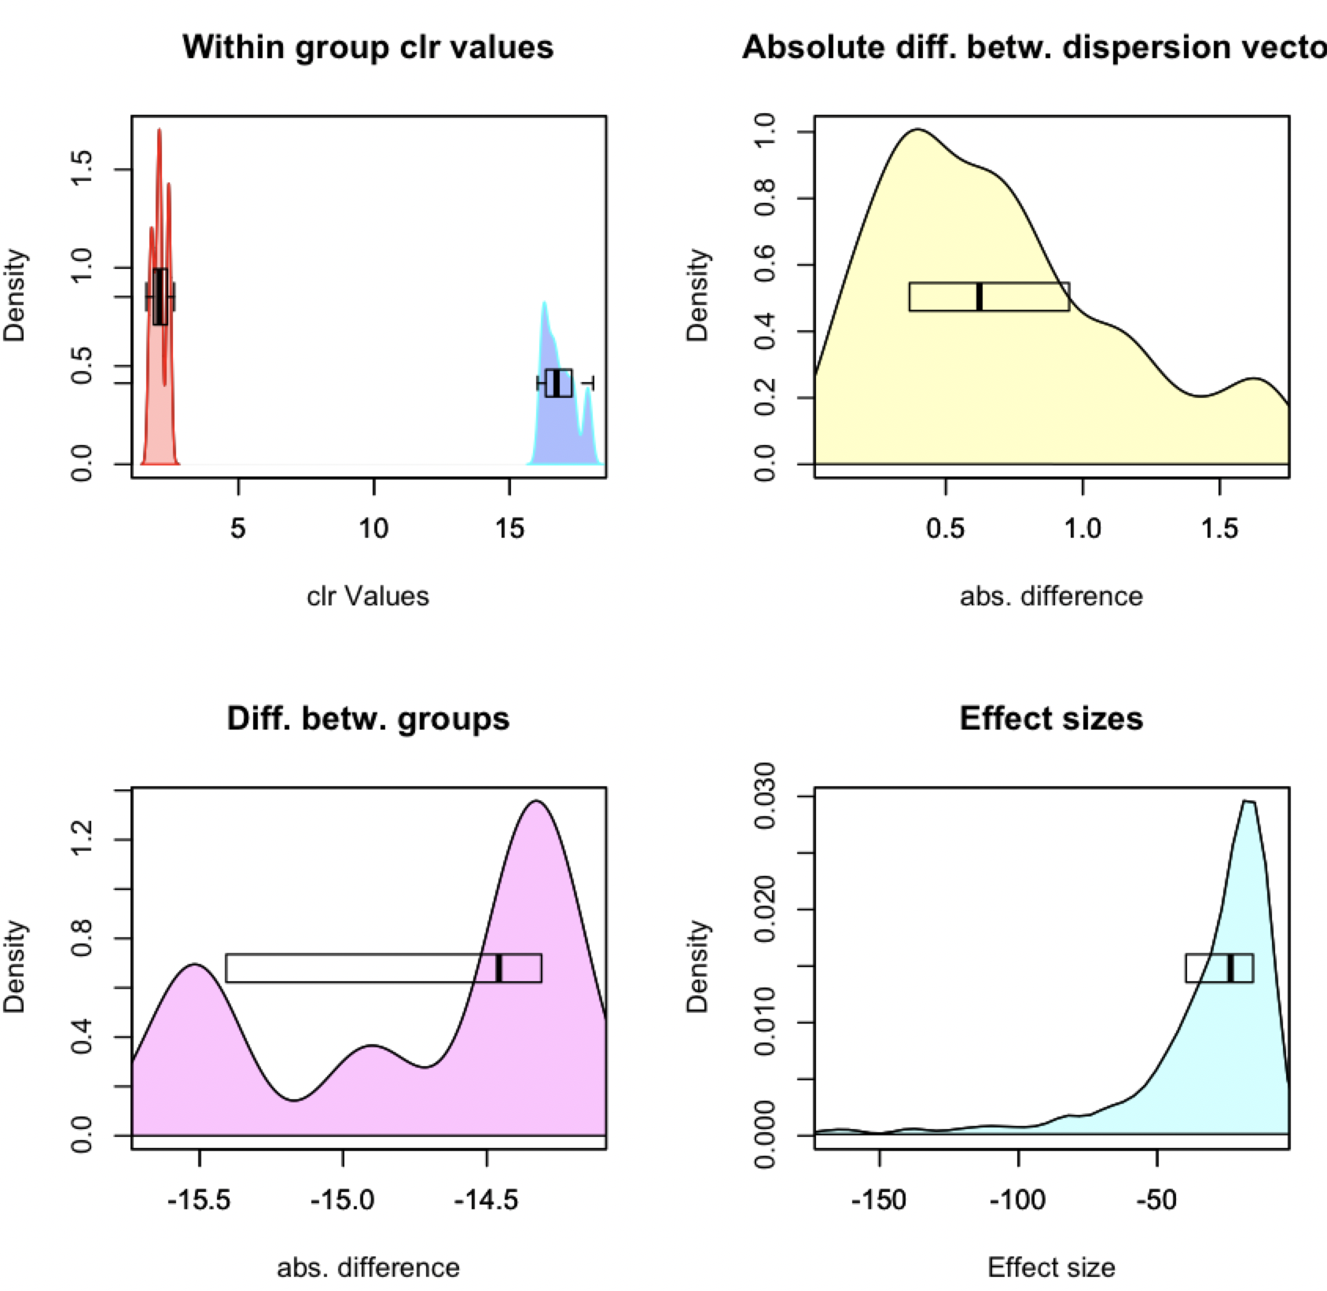
ALDEx2 under the hood
CLR Distribution
Dispersion
aldex.plotFeature()
Difference
Effect

Slide 16
Meta-transcriptomics of an ecosystem
Difficult datasets
Sequencing all the mRNA in a collection of bacteria
Information about what is being made now
Often unbalanced
Different conditions can have different taxonomic compositions
Both absolute and relative abundance of the taxa and their transcripts can change
Relative abundance does not necessarily reflect environmental reality in sequencing data

Slide 17
Test dataset - bacterial vaginosis
Marked asymmetry in bacterial composition
H is predominantly Lactobacillus sp.
BV is mixed bag of anaerobes with L. iners
Marked asymmetry in functional composition
Asymmetrically sparse functions
Asymmetrically expressed functions
Group genes to functional level (SEED, KEGG, InterPro, etc)
If everything is different, then nothing is important
We must assume something is invariant

Slide 18
Datasets
Vaginal swab – treatment naïve (S)
Vaginal wash – BV treatment naïve, H post-metronidazole (W)
Deng et al. mSphere 2018
Annotate reads using same pipeline
VIRGO/SEED
Keep functions shared by both

Slide 19
BV dataset with edgeR tool
Bland-Altmann Plot
Each function is a point
Red are ‘DE’
Obviously unbalanced dataset
What assumptions do not fit?
Majority invariant?
Dispersion ~ abundance?
Equal number of parts
0 is always 0
Notes:
Breaks the assumptions
Note the midpoint of the dataset is off the 0 line

Slide 20
Need to center the data
All
One
Robust midpoint variance
Low variance, high abundance
Median

Slide 21
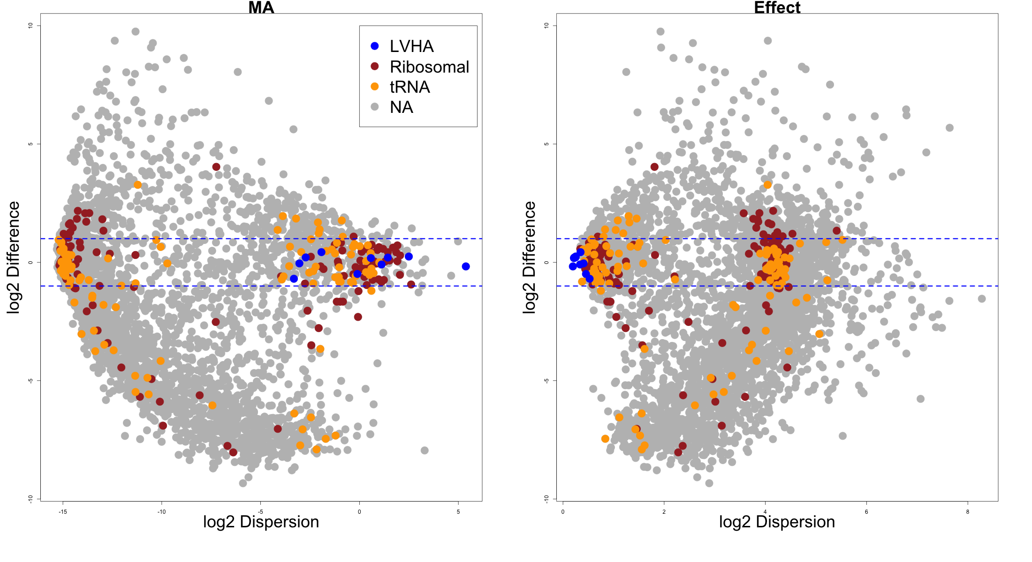
Housekeeping genes centred

Slide 22
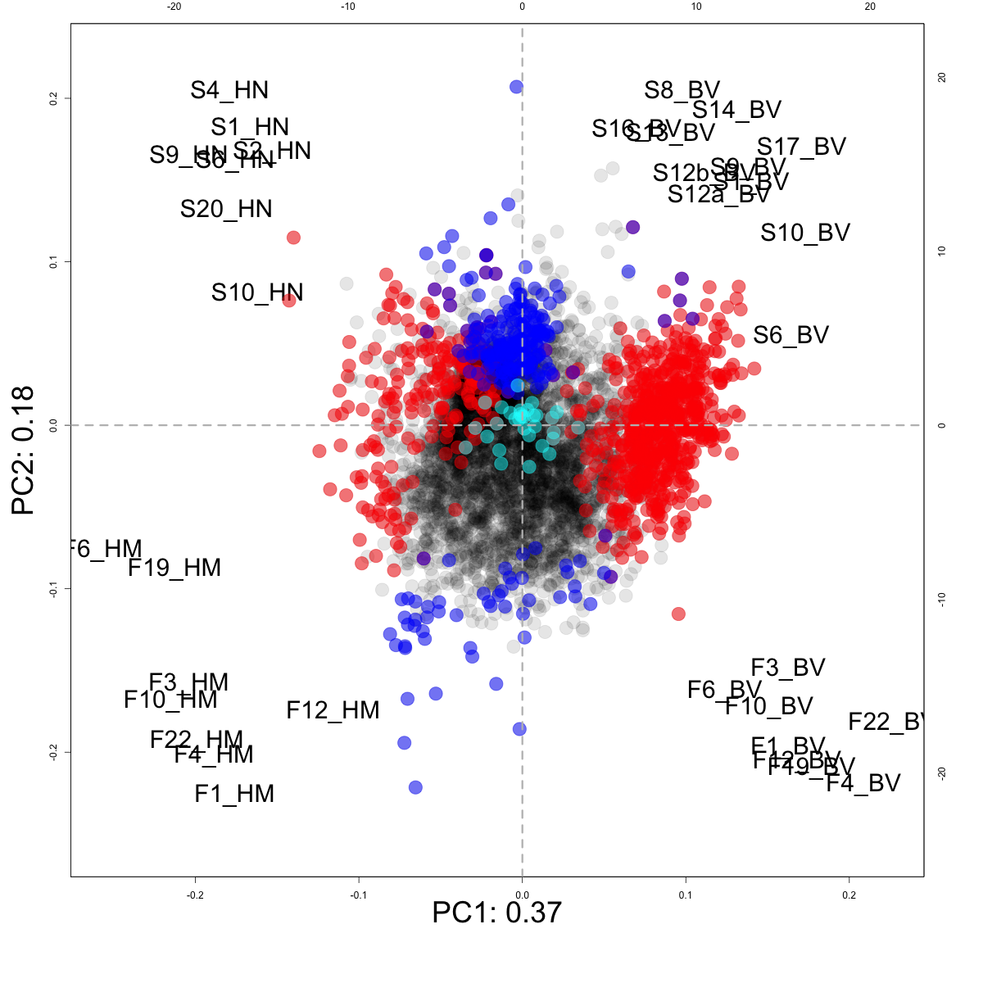
Distinct datasets:
Not different
LVHA
S vs F
H vs BV

Slide 23
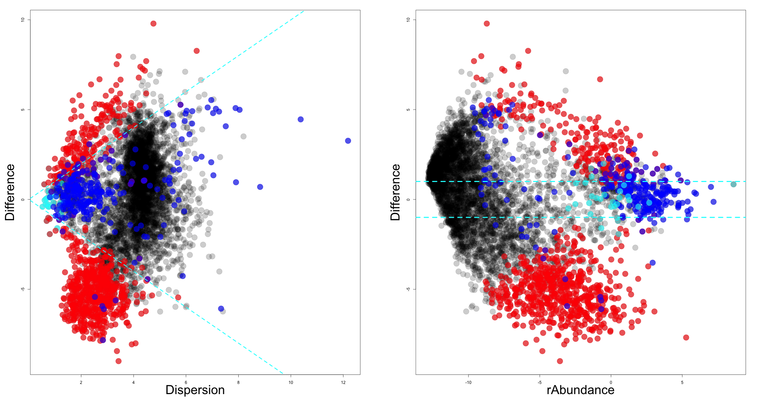
Effect (ALDEx2 E(glm))
Not different
LVHA
S vs F
H vs BV

Slide 24
Species from gene mappings

Slide 25
Genes by organism

Slide 26
BV gene level

Slide 27
BV Distinguishing features

Slide 28
H gene level

Slide 29
Conclusions
Meta-transcriptomes are hard
Can at least get reproducible answers across datasets
Asymmetry in datasets is surprisingly common
Proper centering is needed to prevent non-sensical answers
ALDEx2 makes a probabilistic distribution of the data
Only assumption is random sampling
Something is invariant
Manipulates the probability distributions using rules and tools of CoDa
Fully general method

Slide 30

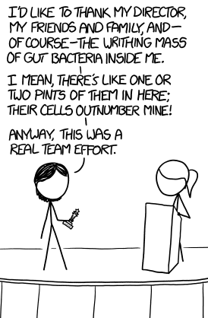


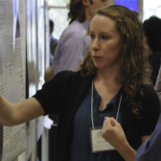




Andrew
Fernandes
Jean
Macklaim
Vera Pawlowsky-Glahn
Juan Jose Egozcue
Justin Silverman
philr
Tom Quinn
propr
Gregor Reid
Jeremy Burton
Daniel Giguere

Slide 31
Real sequence data are variable
Same features from same samples from the same library
Sequenced on different lanes
We should get comparable answers
We can estimate the variability by sampling Dirichlet instances
Multivariate, constrained balls in an urn
Fernandes, PLoS ONE 2013
Gloor, Aus J. Stat. 2016

Slide 32
Think of the 0s!
0 count can be real – or a non-detect
0 count is not 0 probability to detect the count
p_{i} = 0 is strong, invalid, assumption
[P_{i} > 0, P_{i} →0]
EBI Hinxton
Fernandes, PLoS ONE 2013
Gloor, Aus J. Stat. 2016

